Slide 1



Wio Terminal – Part 1 Installation & Tests
Prof. Marcelo José Rovai
UNIFEI - Federal University of Itajubá, Brazil
TinyML4D Academic Network Co-Chair

Slide 2
The Wio Terminal

Slide 3
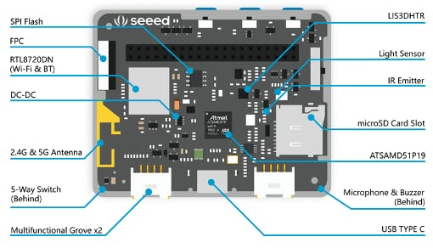
The Wio Terminal
The Wio Terminal uses an ATSAMD51P19 microcontroller with ARM Cortex-M4F running at 120MHz (boost up to 200MHz), 4MB of external flash memory, and 192KB of RAM.
Wireless connectivity with Realtek RTL8720DN support. It is compatible with Arduino and MicroPython. It supports Bluetooth and Wi-Fi. There is a 2.4-inch LCD screen on Wio Terminal, an onboard Accelerometer (LIS3DHTR), a microphone, a buzzer, a microSD card slot, a light sensor, and an IR emitter (IR 940nm).
It has two multi-functional Grove connectors (I2C and Dig/Analog GPIOs) and Raspberry Pi-compatible 40-pin GPIO pins for additional add-on support.
https://wiki.seeedstudio.com/Wio-Terminal-Getting-Started/

Slide 4
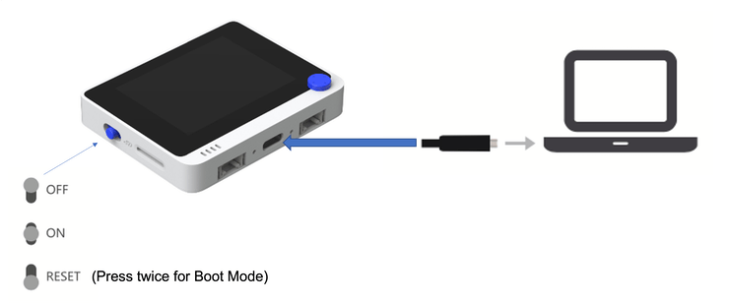
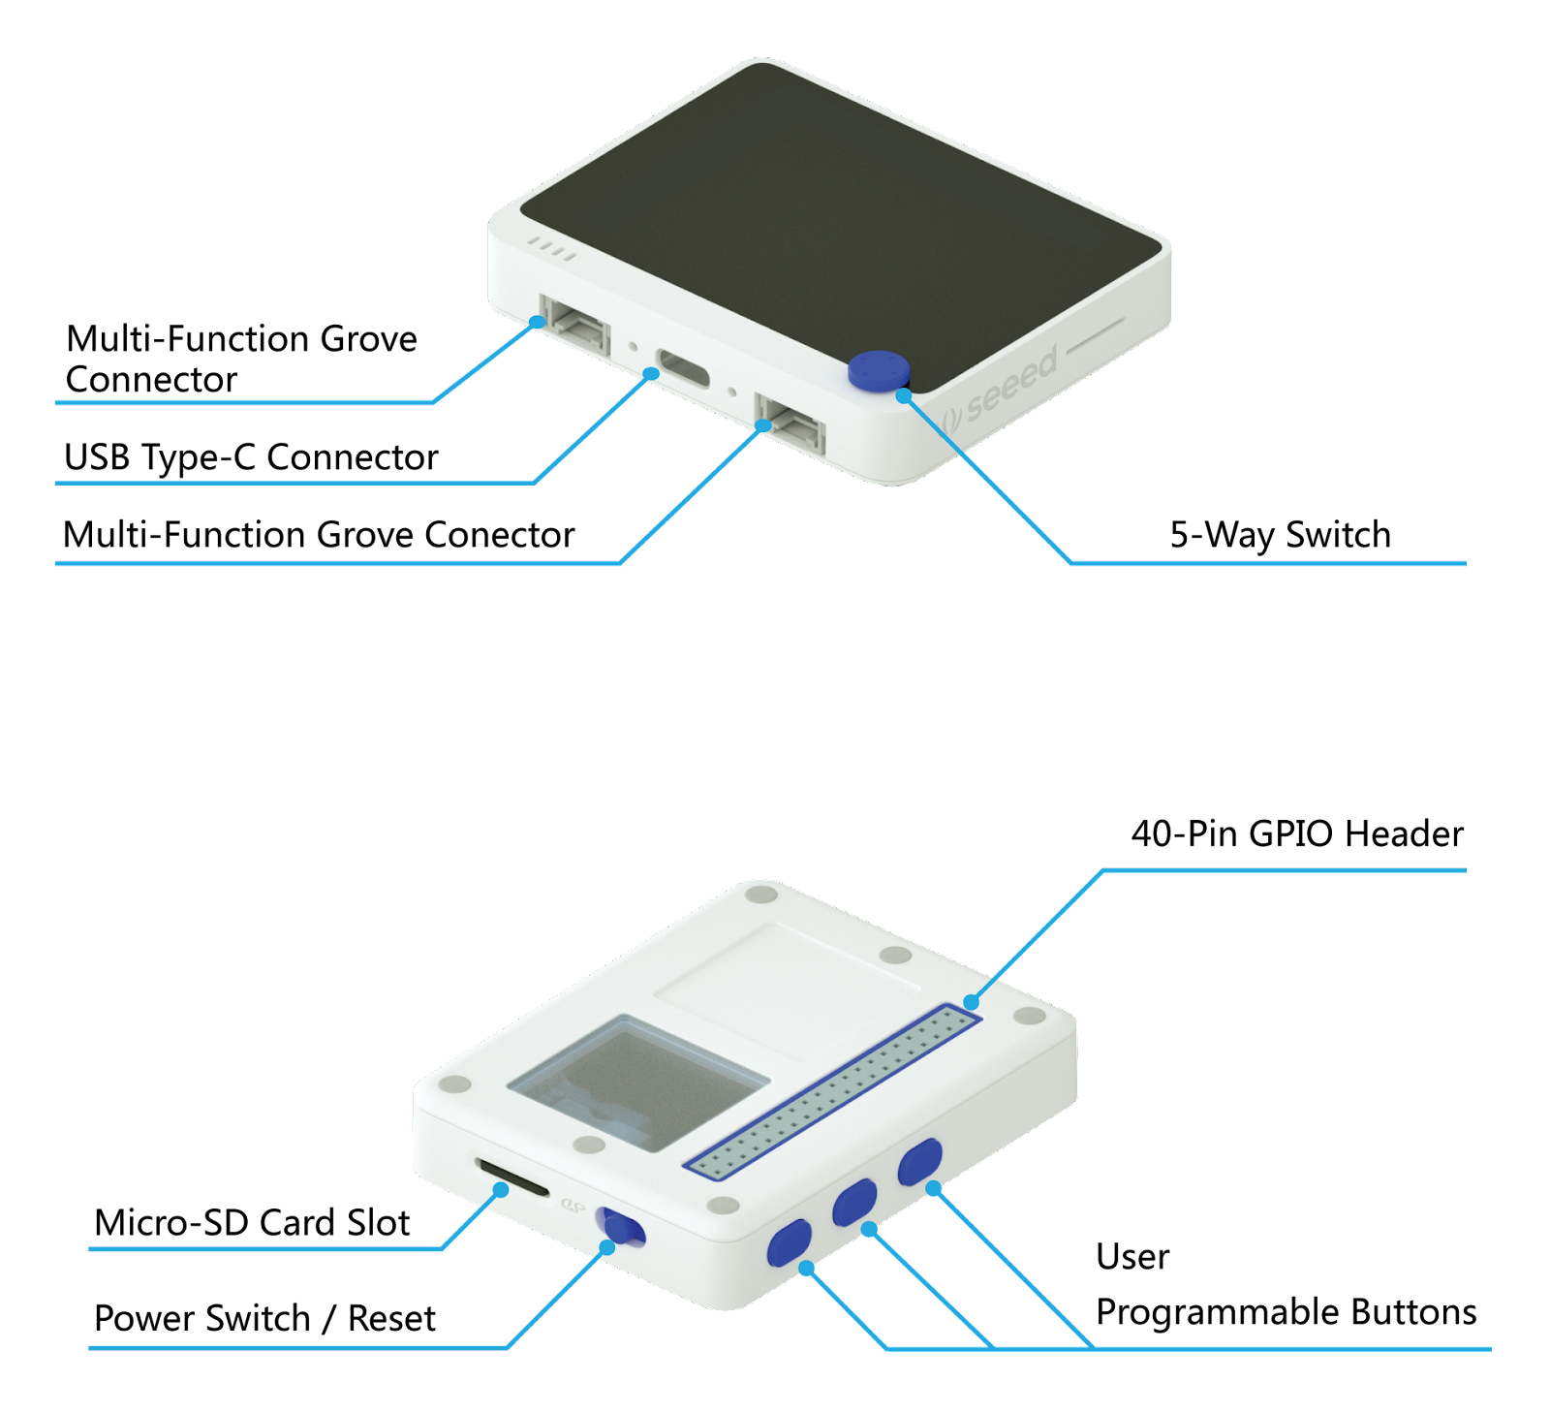
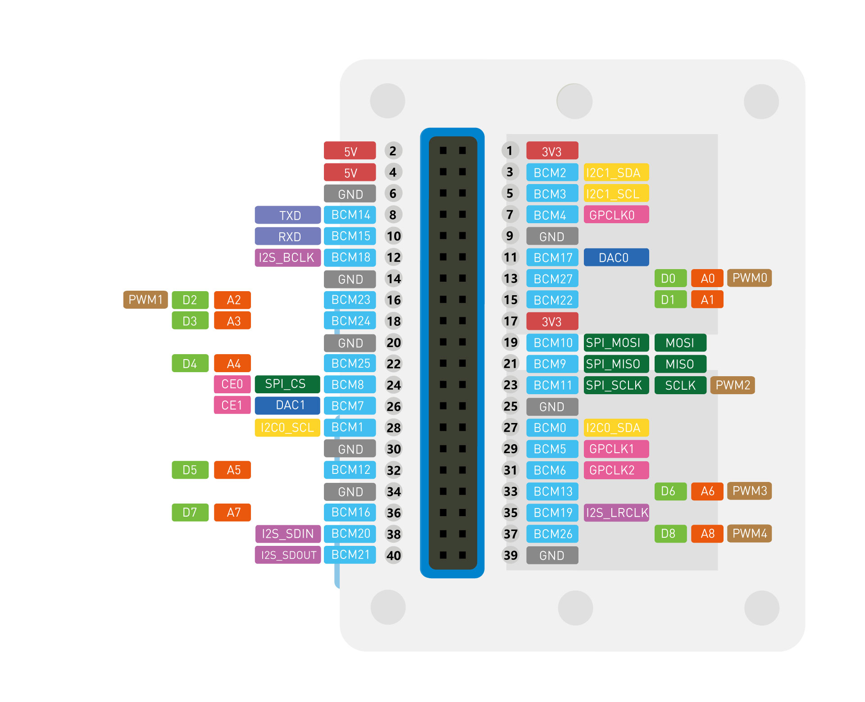
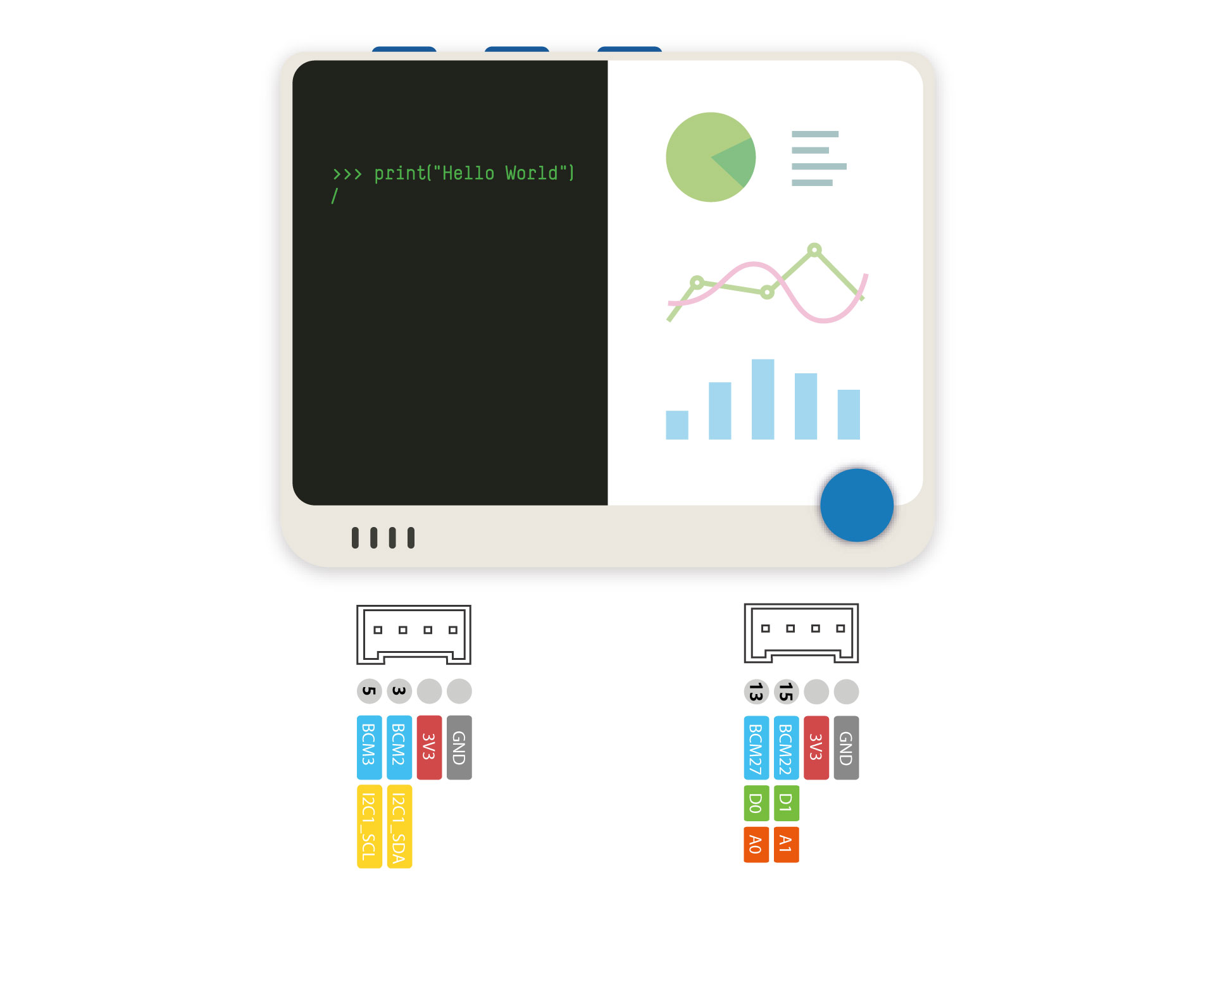
The Wio Terminal – Hardware installation / Expansion
Analog
& Digital
Raspberry Pi - 40 Pin
I2C

Slide 5
Installing Wio Terminal – Arduino IDE

Slide 6
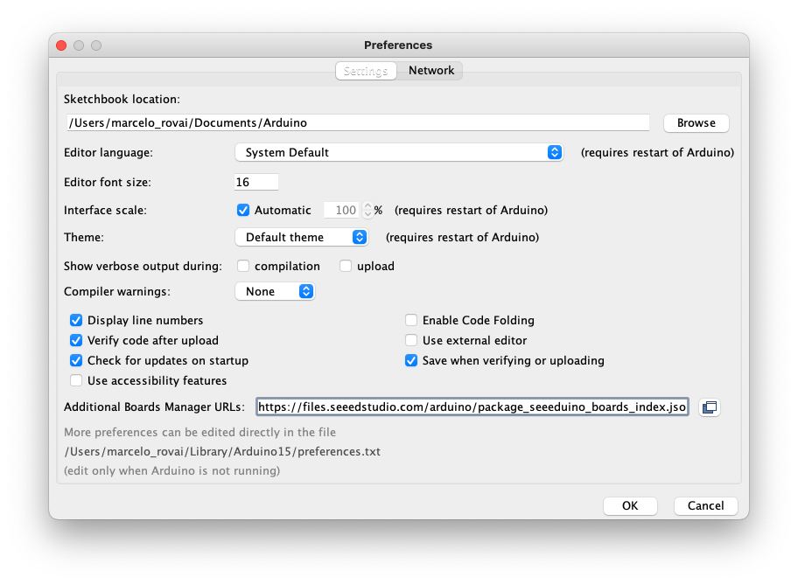
Open the Arduino IDE, and click on:
File > Preferences, and copy the below URL to Additional Boards Manager URLs:
https://files.seeedstudio.com/arduino/package_seeeduino_boards_index.json

Slide 7
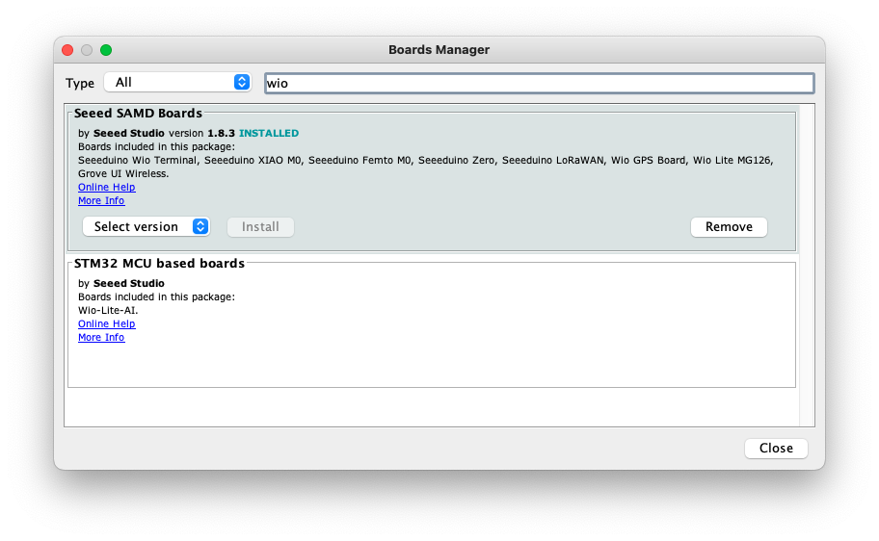
Click Tools > Board > Board Manager and Search Wio Terminal in the Boards Manager.
Install the last available version.

Slide 8
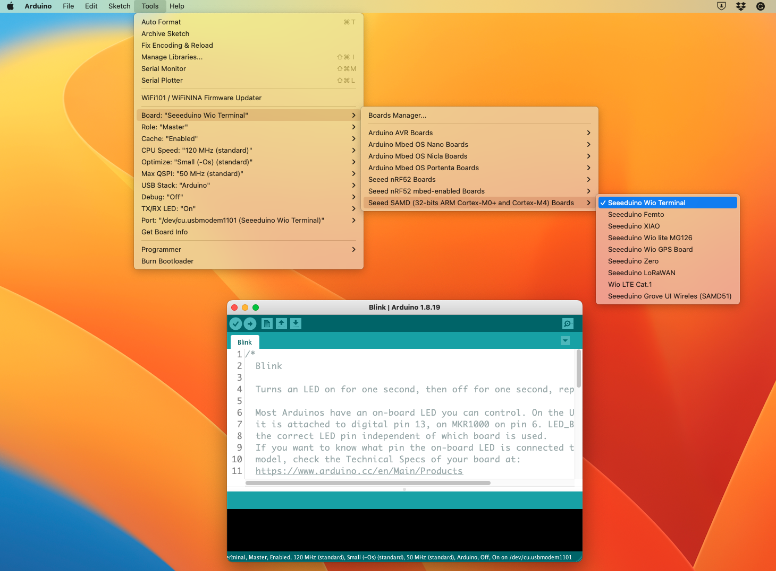
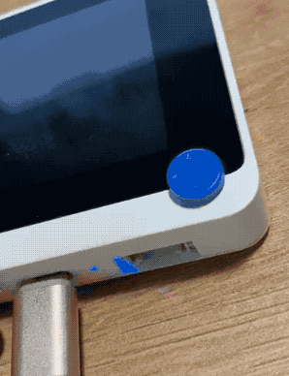
Select your board and port. Load the Blink sketch and run it.

Slide 9
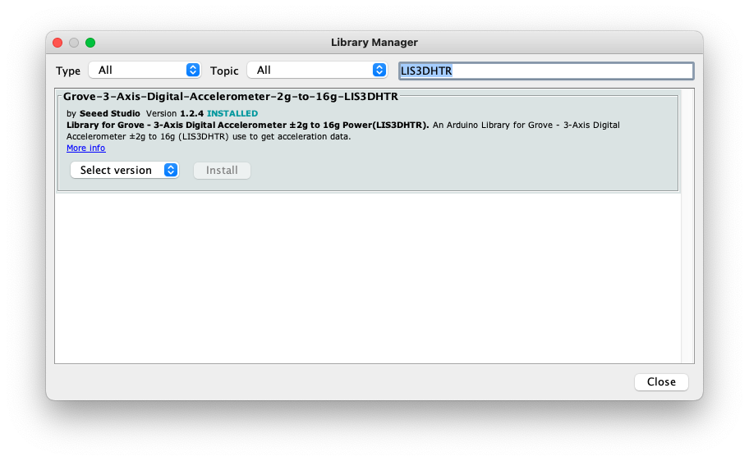
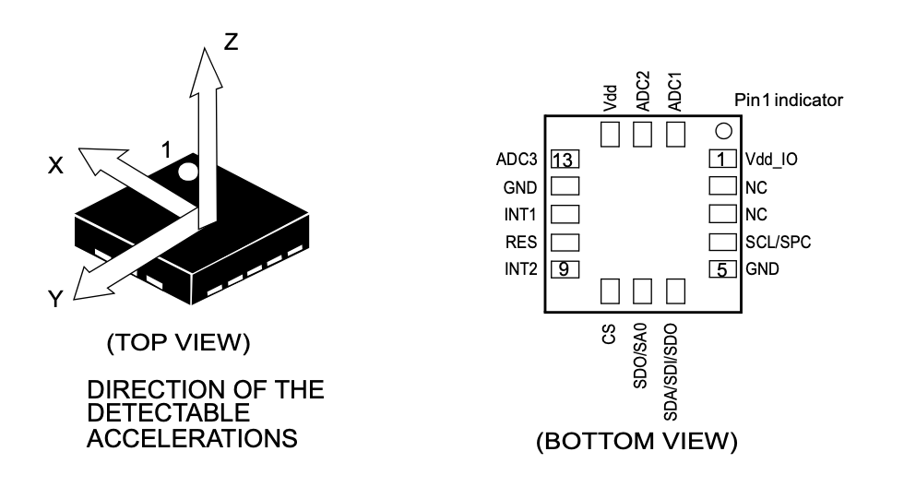
Installing the 3-Axis Digital Accelerometer(LIS3DHTR) Library For Wio Terminal
Click Tools > Manage Libraries .. > and Search in the Libraries Manager.
Install the last available version.
https://www.mouser.cl/datasheet/2/389/cd00274221-1797088.pdf

Slide 10
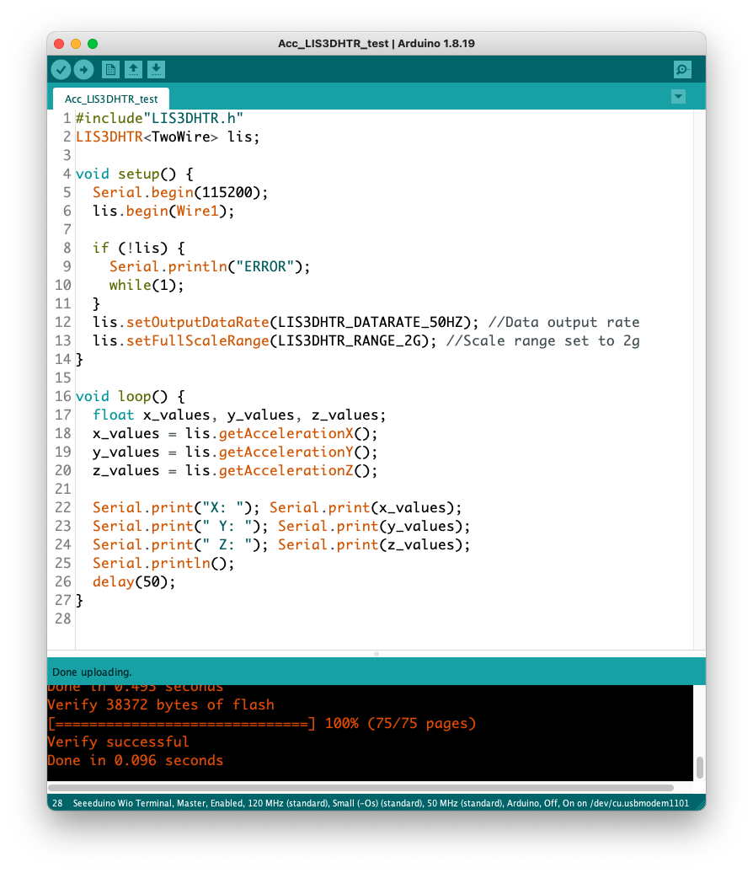
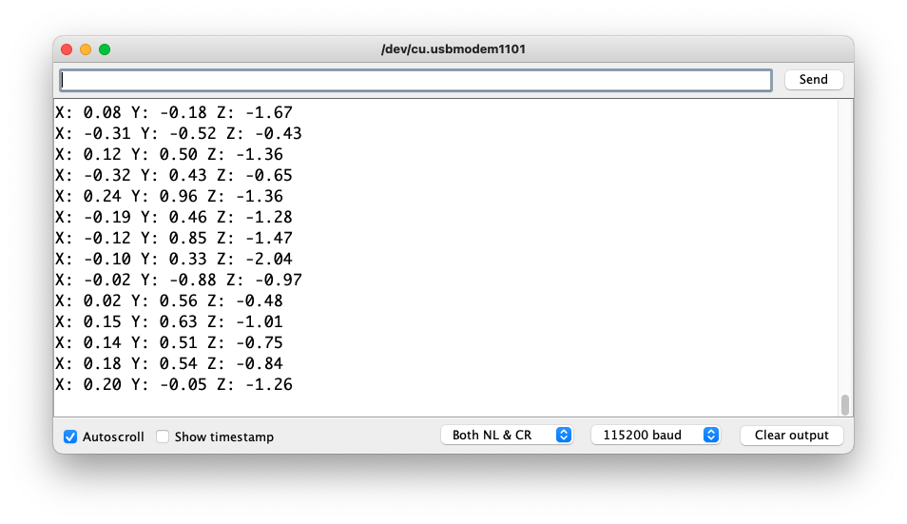
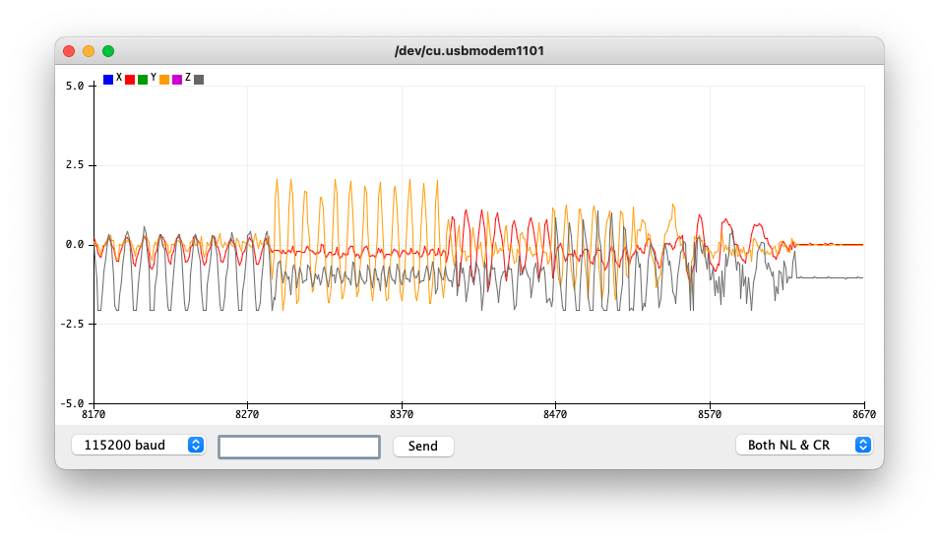

Slide 11
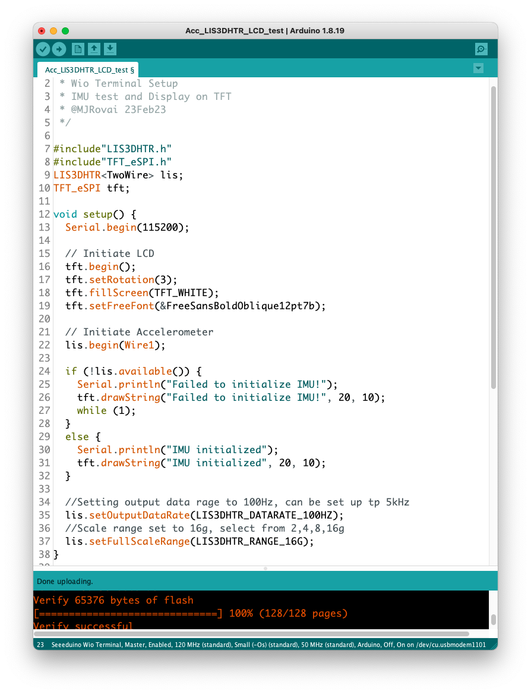
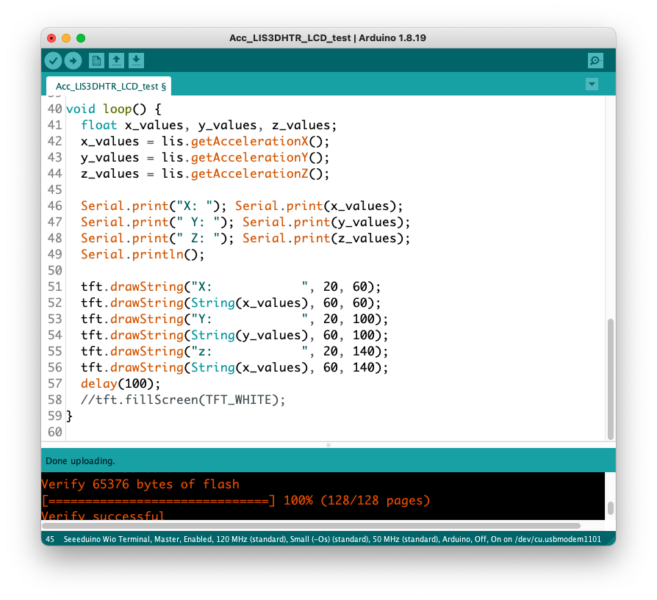
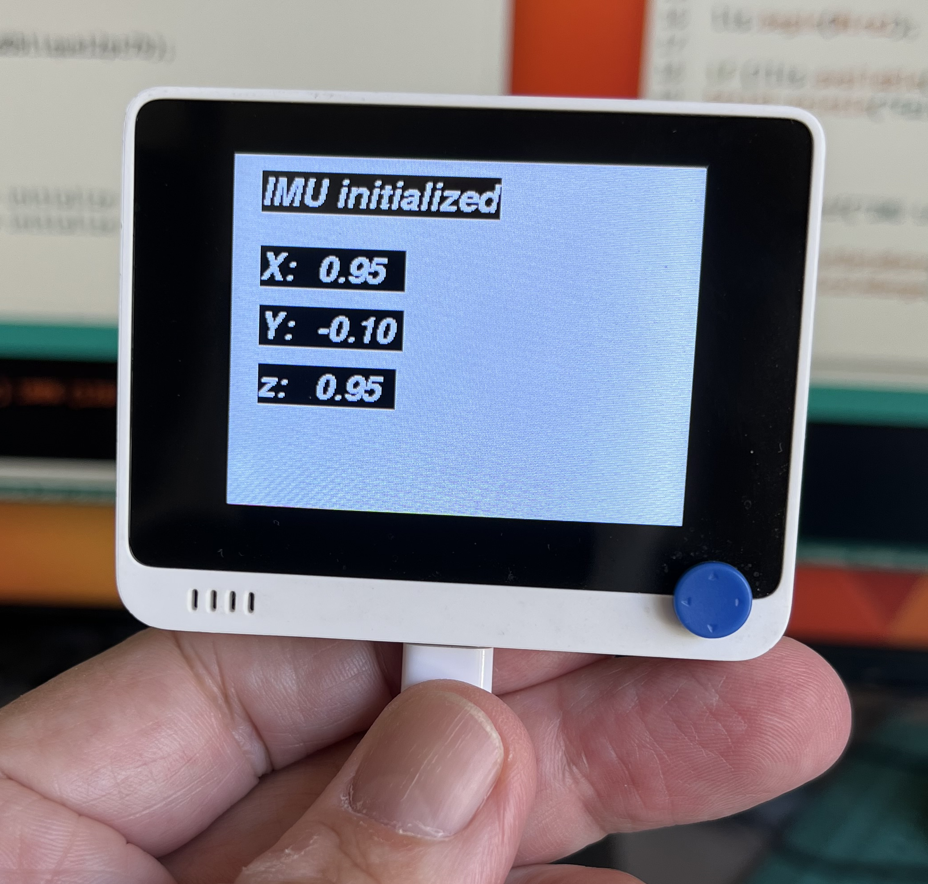
Using the TFT Display

Slide 12
Set up connection between Wio Terminal and Edge Impulse

Slide 13
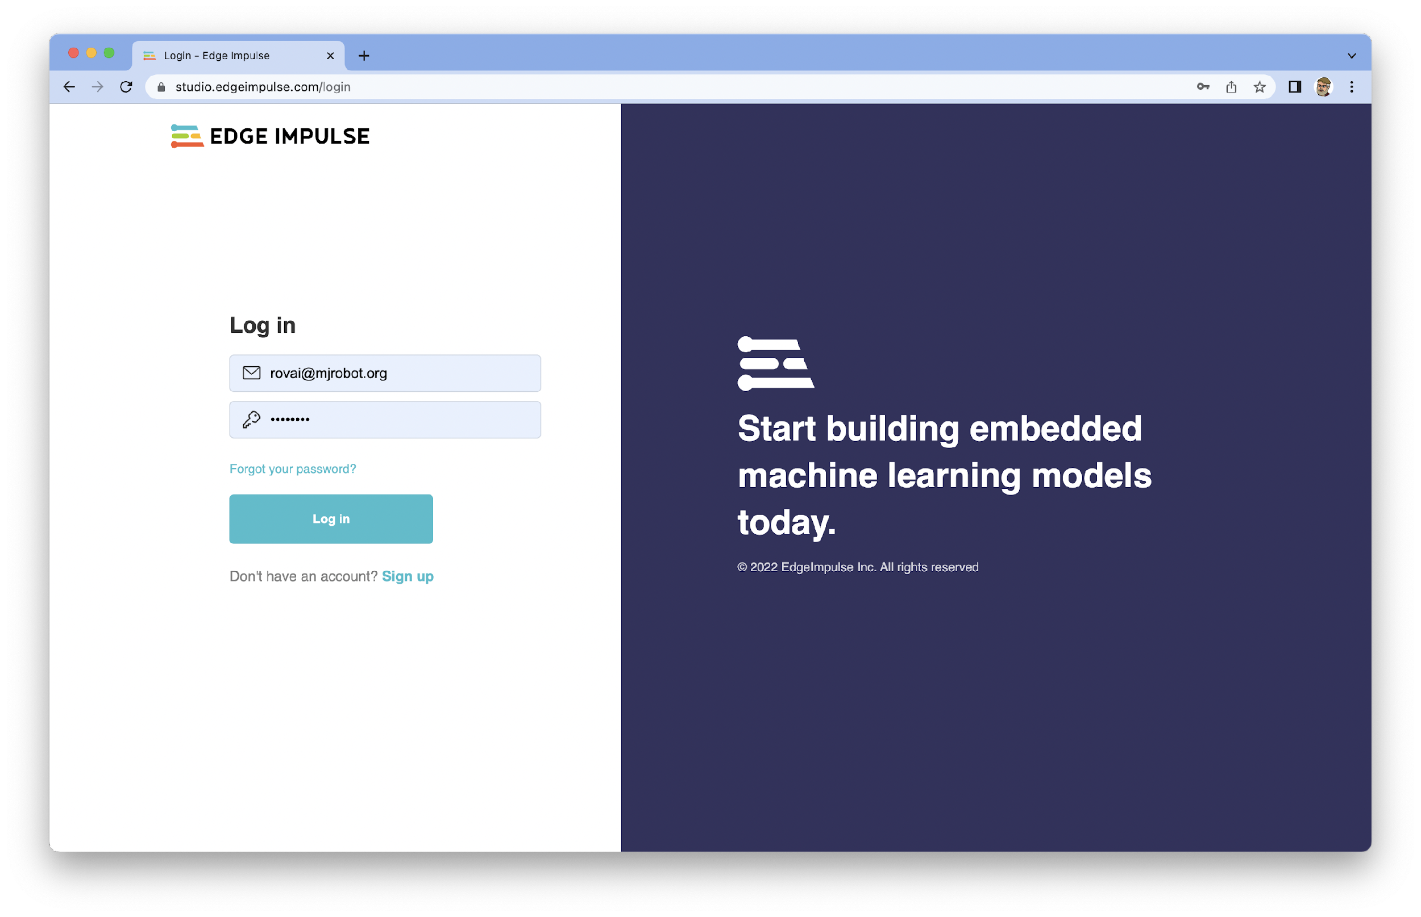

Slide 14
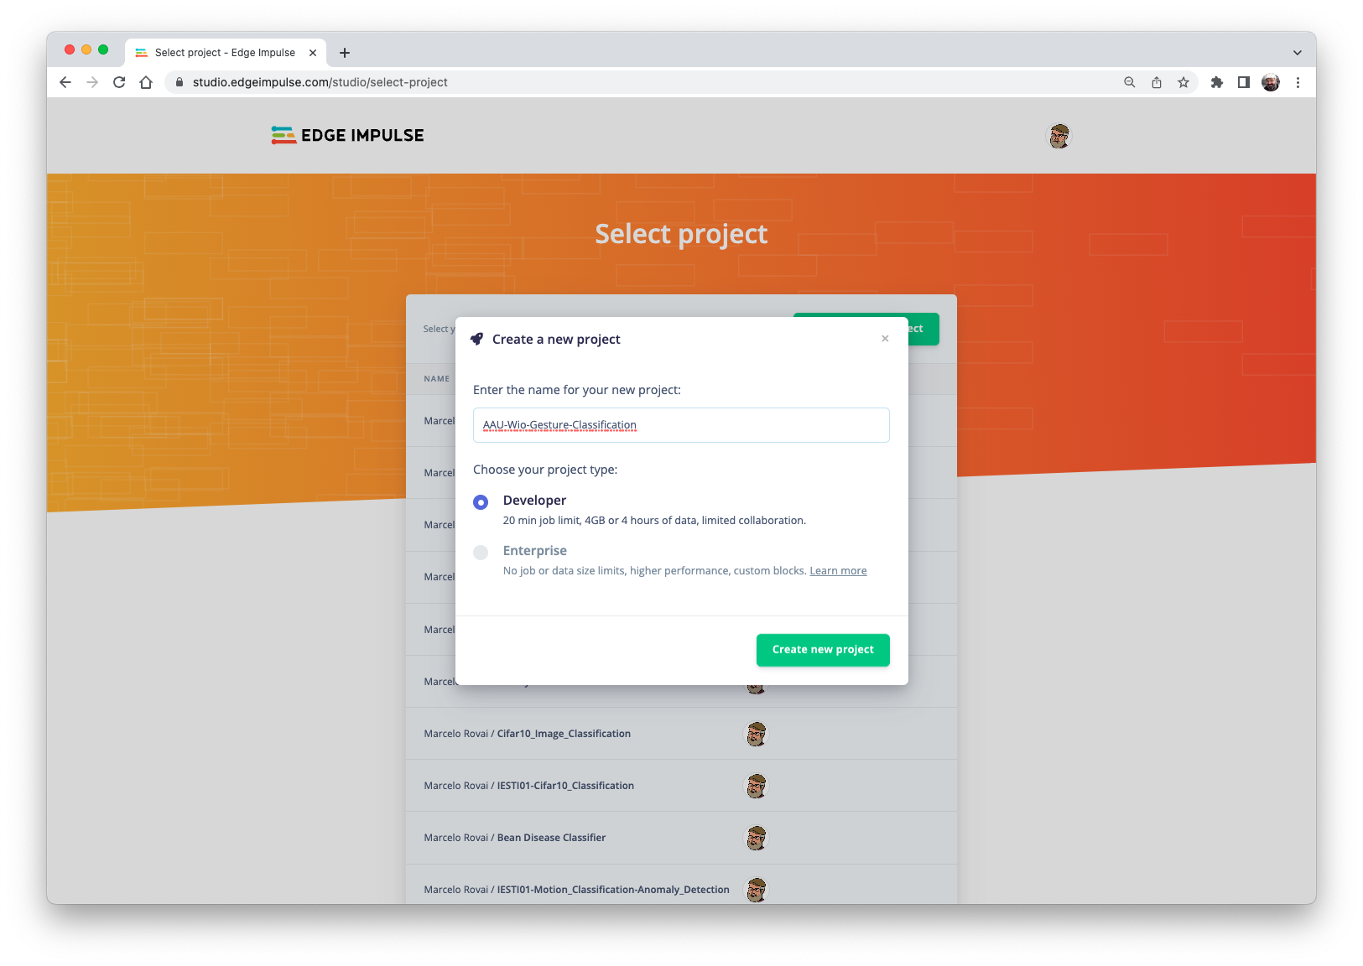

Slide 15
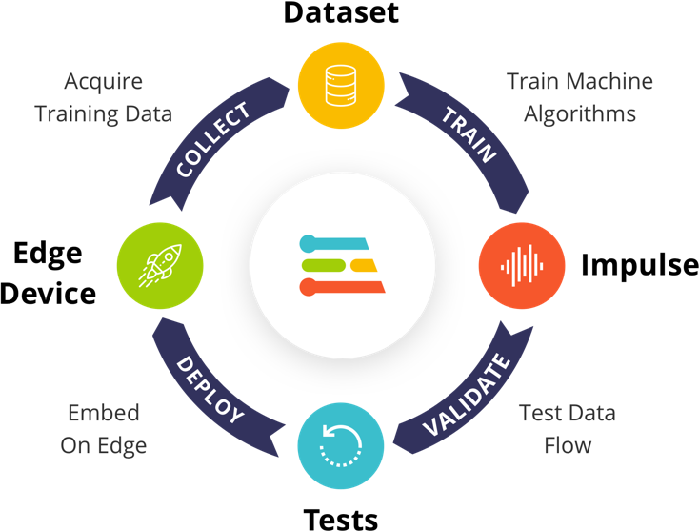
Pre-Processing Data
Design a Model
Train a Model

Slide 16
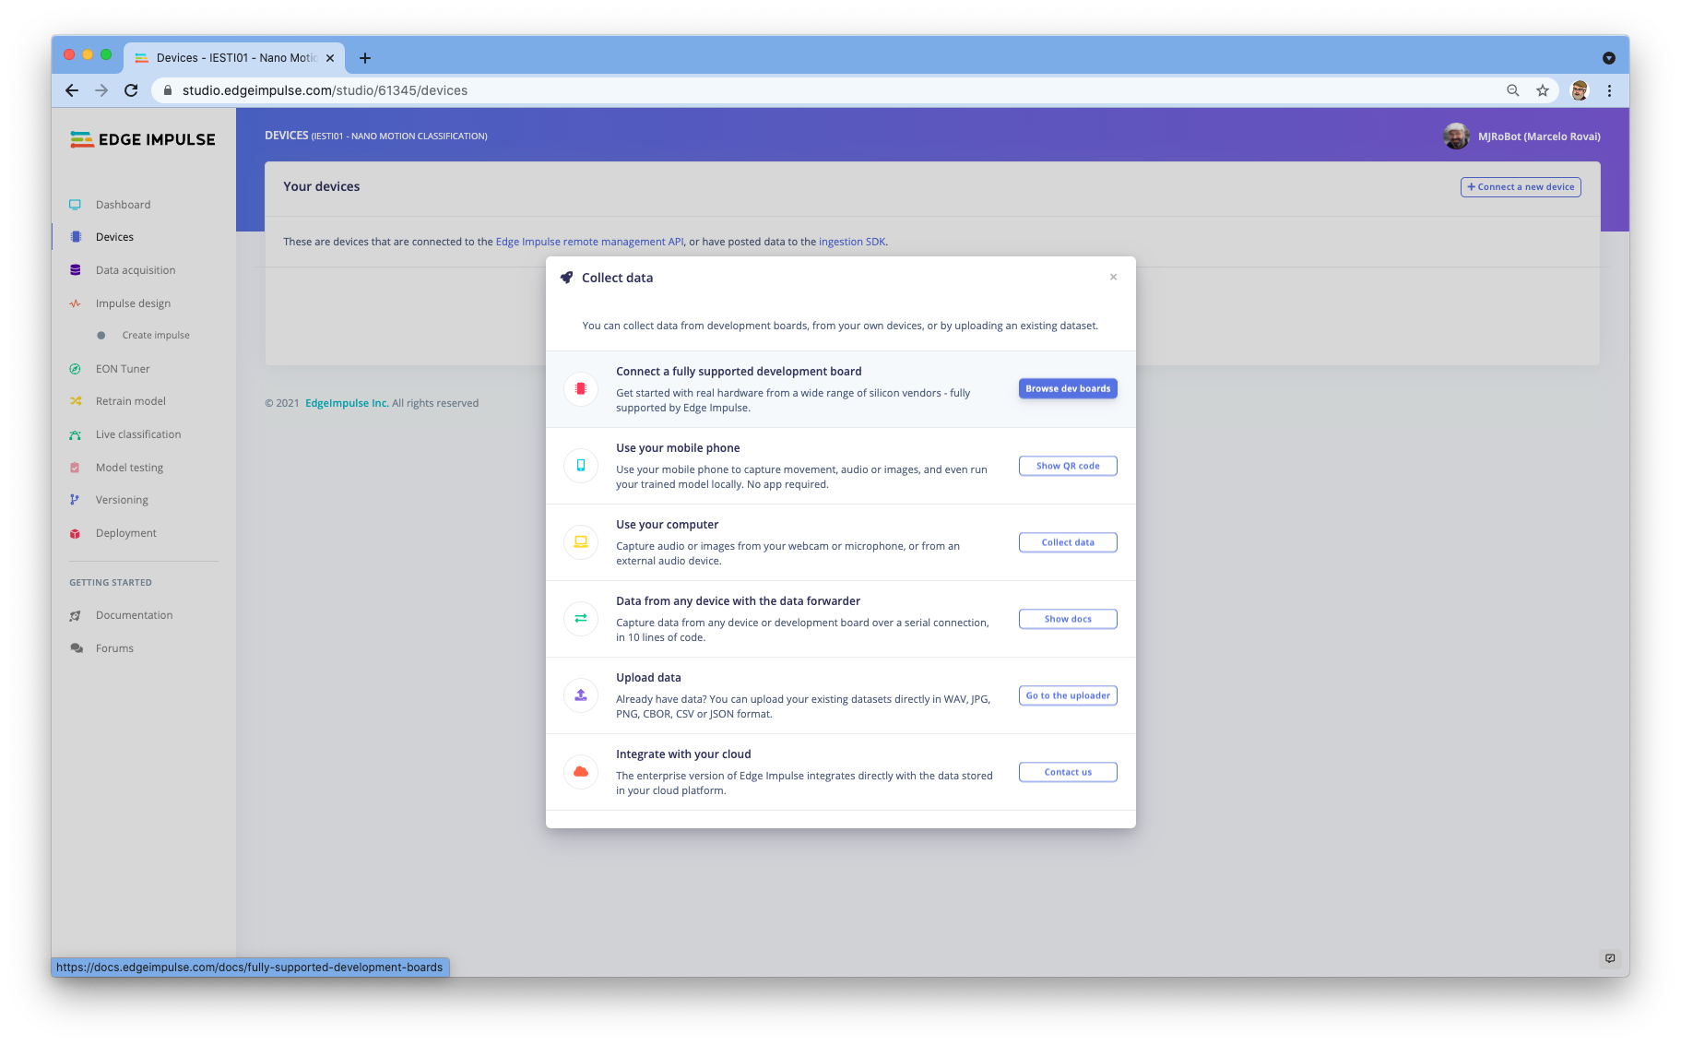
2
1
3

Slide 17
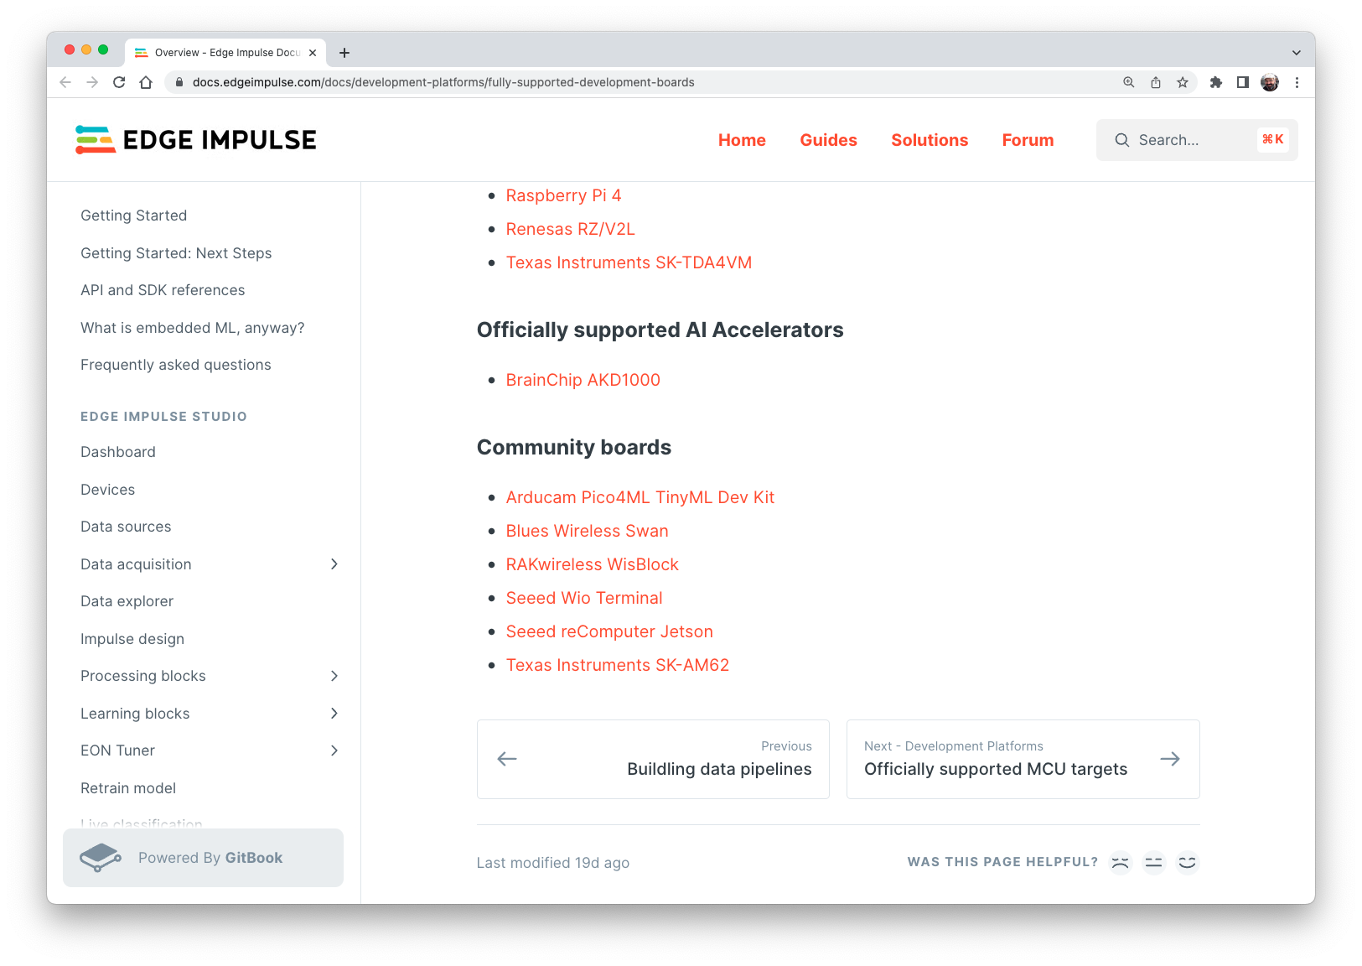

Slide 18
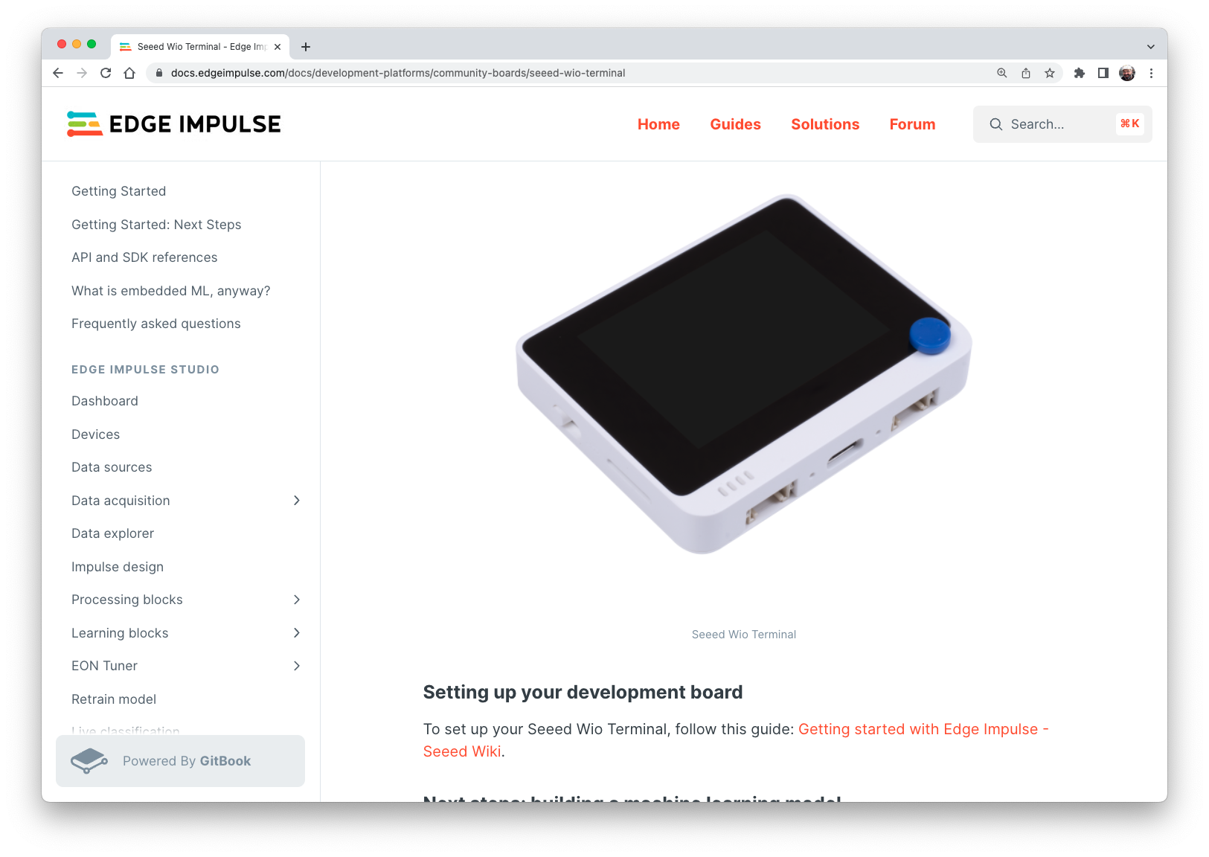

Slide 19
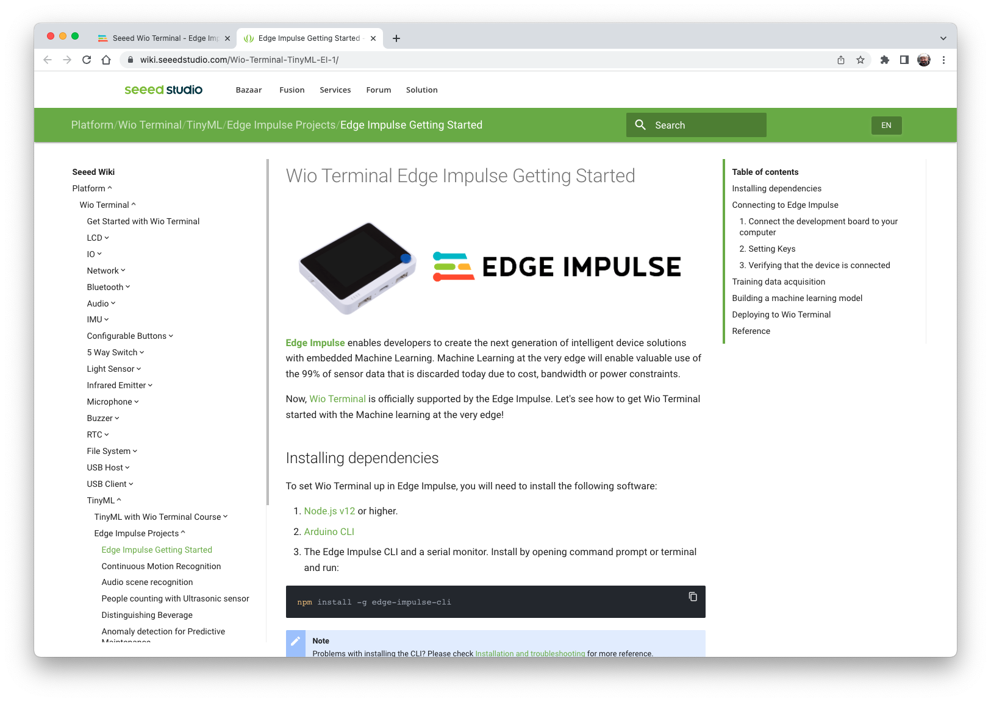
(Note that the 1. Edge Impulse CLI is not necessary for Wio Terminal. We will use WebUSB instead)
Go to 2. Arduino CLI

Slide 20
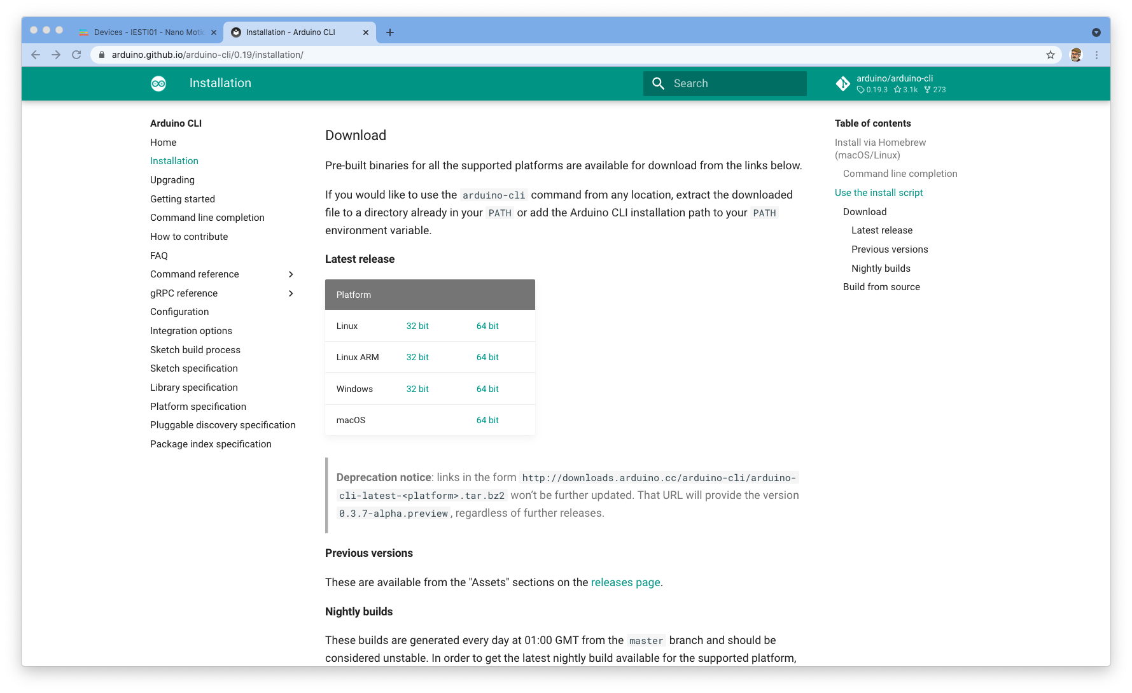
Arduino CLI
See this video for Windows installation: https://www.youtube.com/watch?v=1jMWsFER-Bc

Slide 21
Arduino CLI Installation Summary
If you're on Windows:
Unzip the .zip file to C:\Program Files\arduino-cli
Open System Properties > Advanced > Environment Variables
Path under "user variables" > Edit
Add C:\Program Files\arduino-cli
If you're on macOS:
I recommend using the curl method or homebrew shown on the installation page: https://arduino.github.io/arduino-cli/0.21/installation/
if you use the curl method, it likely installs arduino-cli to ~/bin. That might not be on your path. So, you might need to run: export PATH=$PATH:~/bin

Slide 22
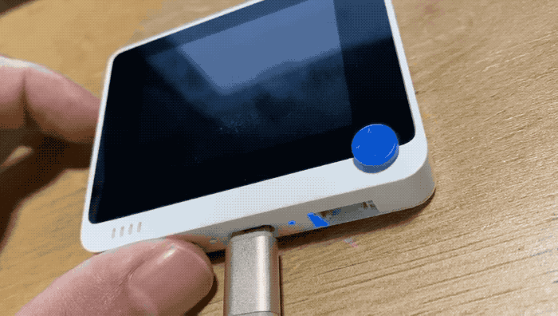
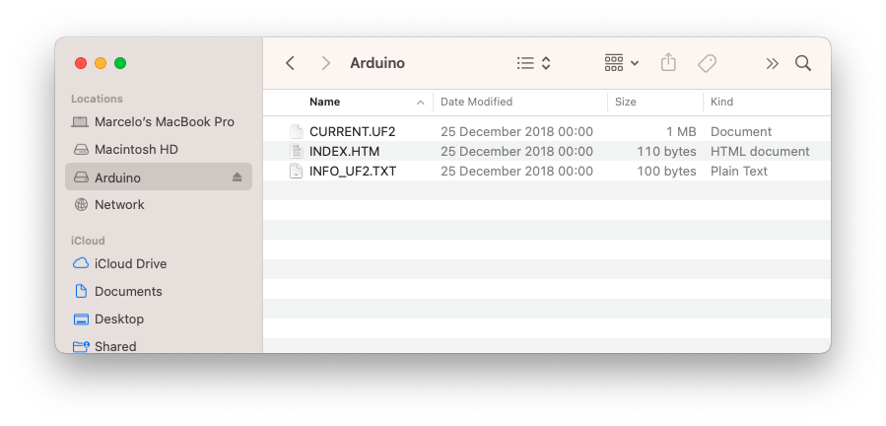
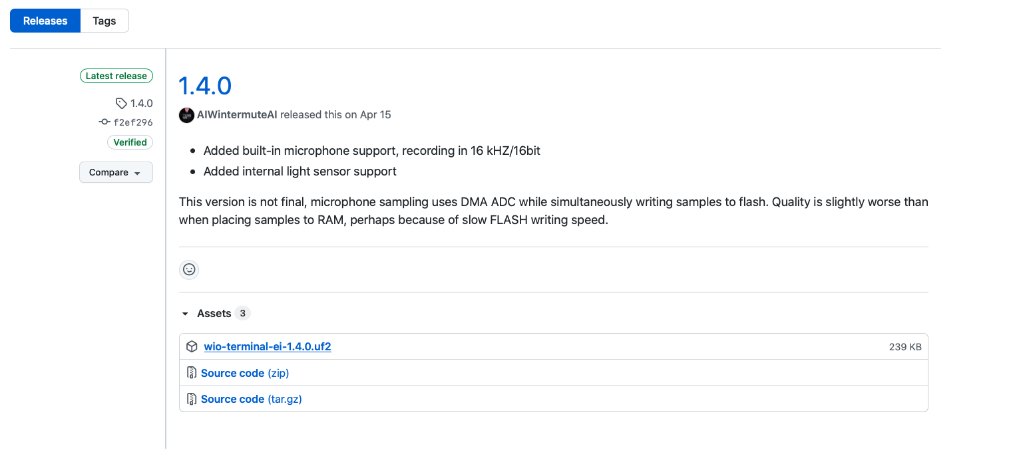
Firmware installation
Connect Wio Terminal to your computer.
Entering the bootloader mode by sliding the power switch twice quickly.
An external drive named Arduino should appear in your PC.
Drag the the downloaded Edge Impulse uf2 firmware files to the Arduino drive. Now, Edge Impulse is loaded on Seeeduino Wio Terminal!

Slide 23
Built-in Sensor’s Test

Slide 24
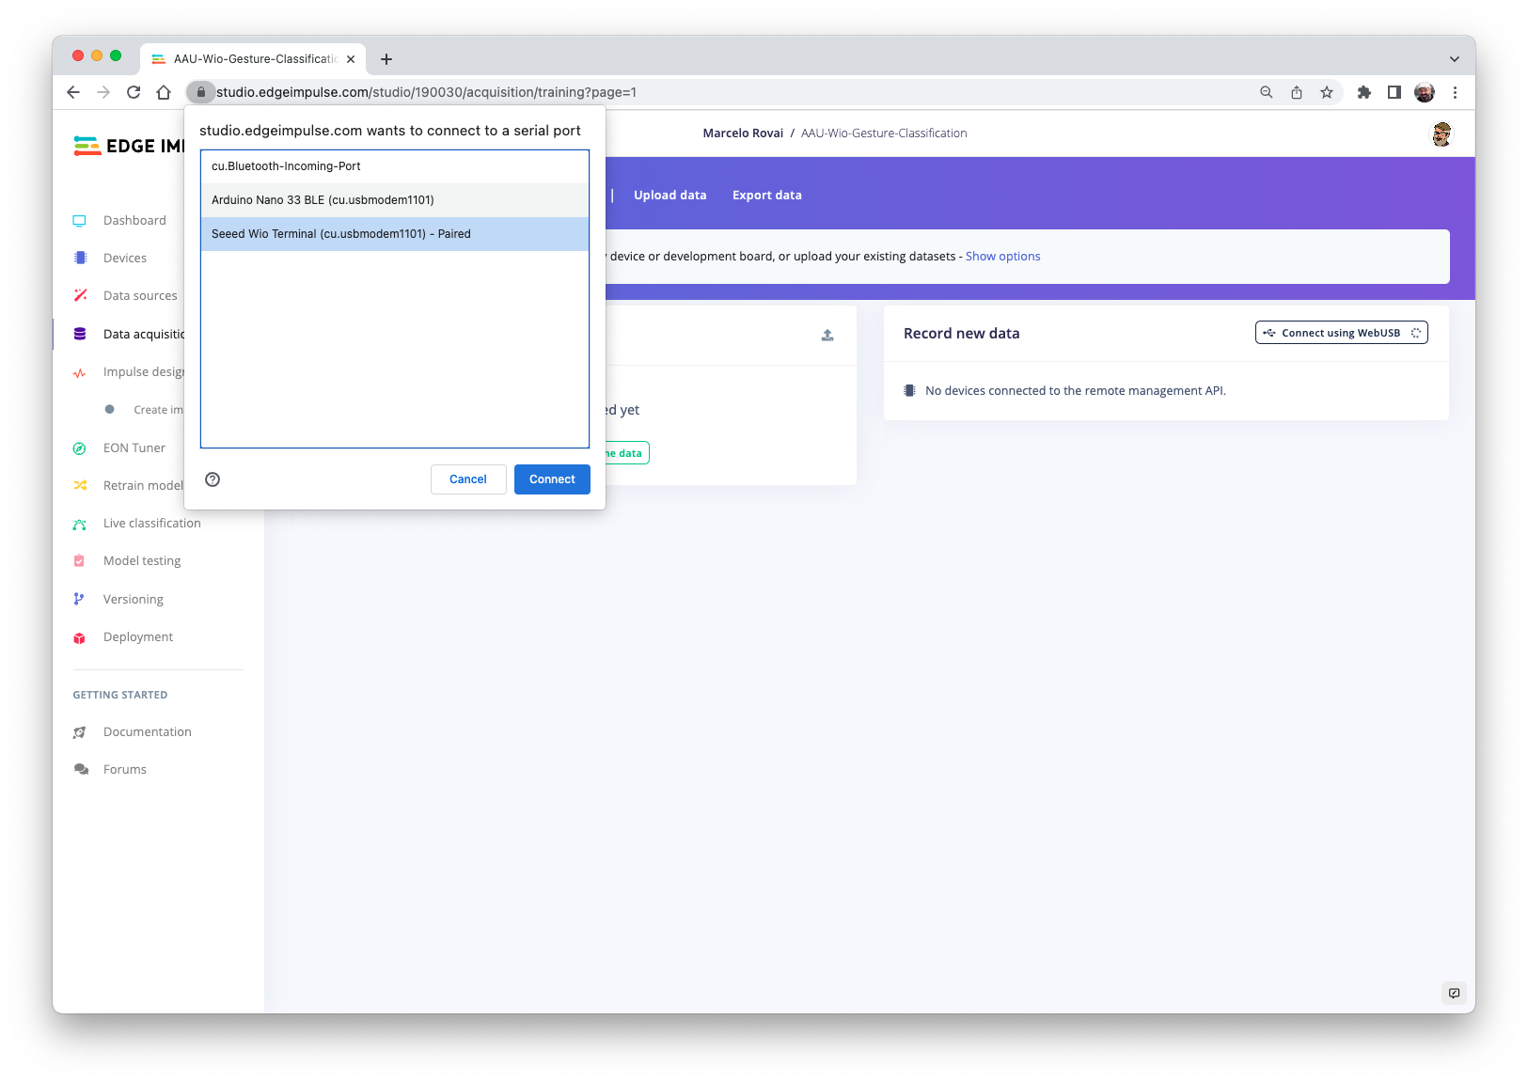

Slide 25
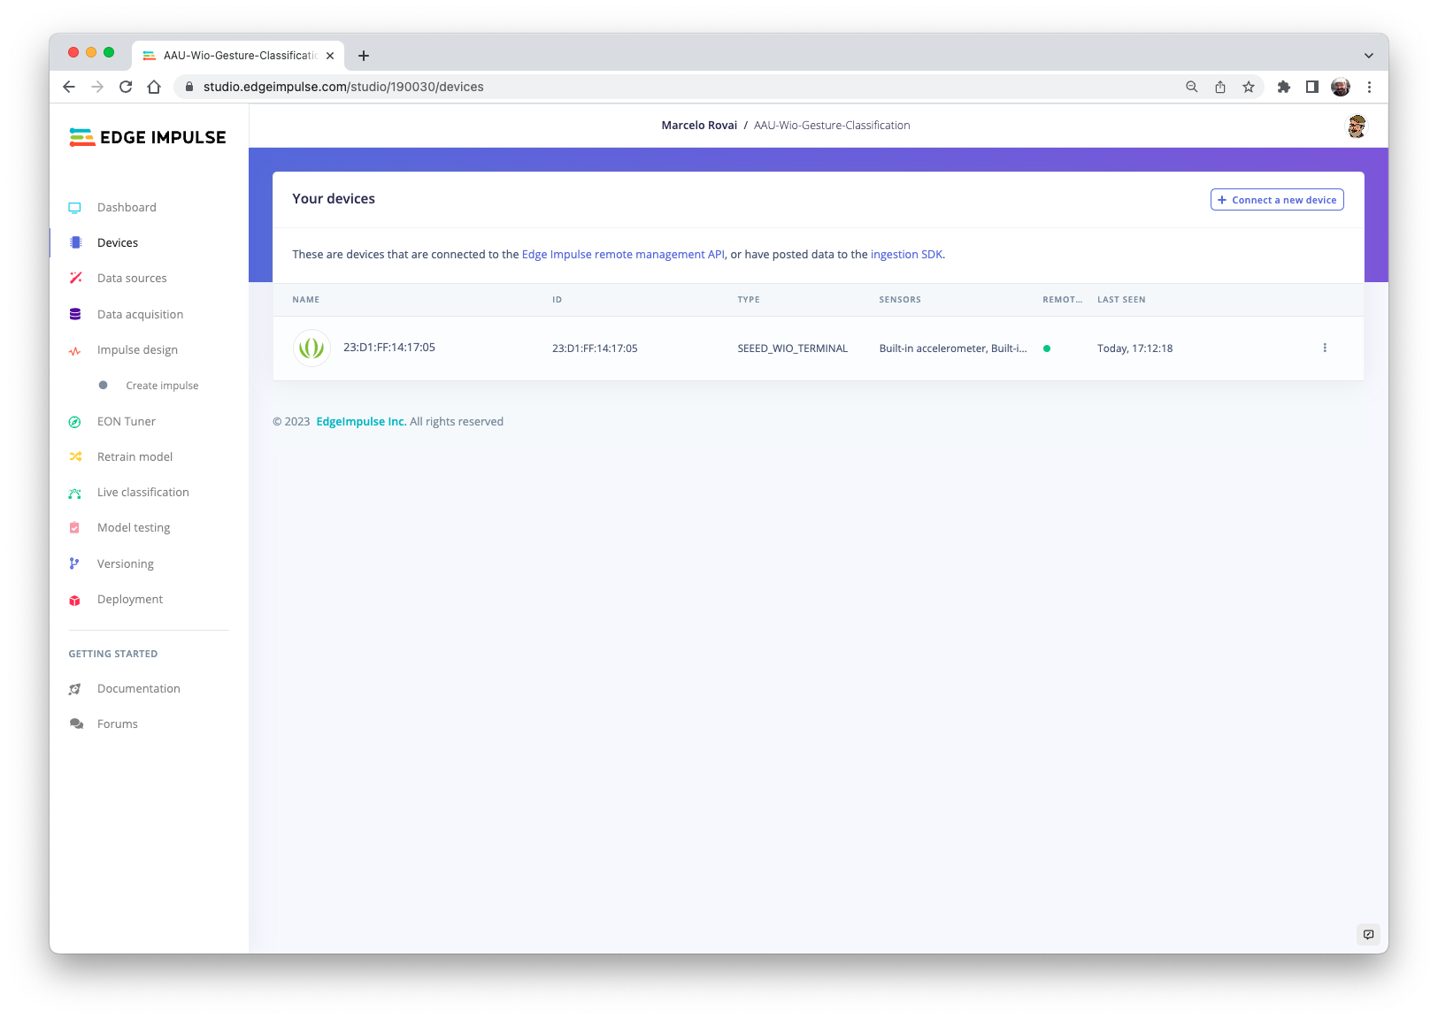

Slide 26
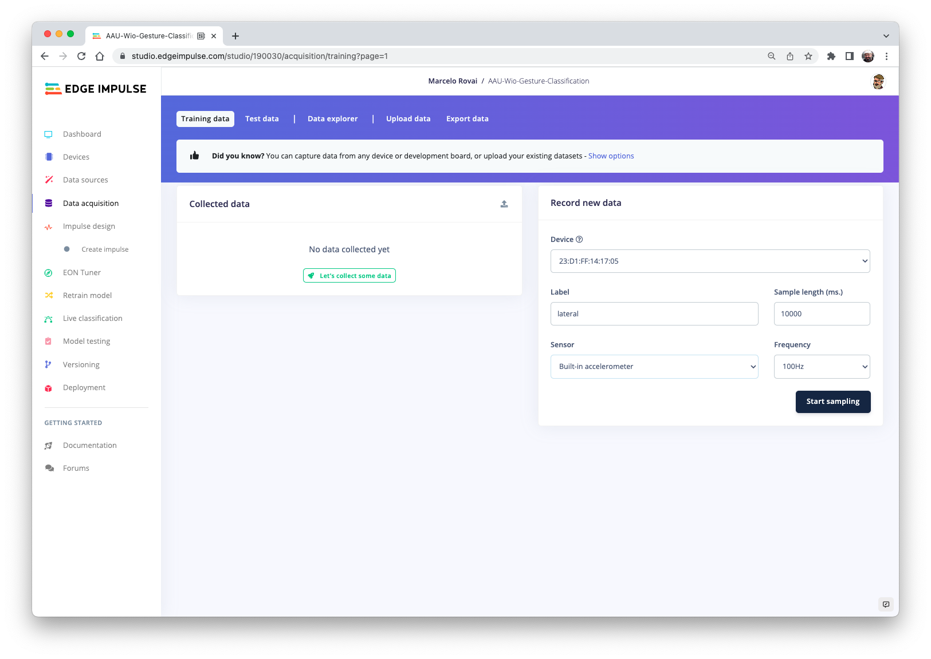
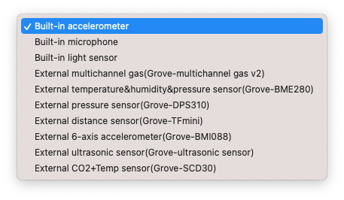

Slide 27
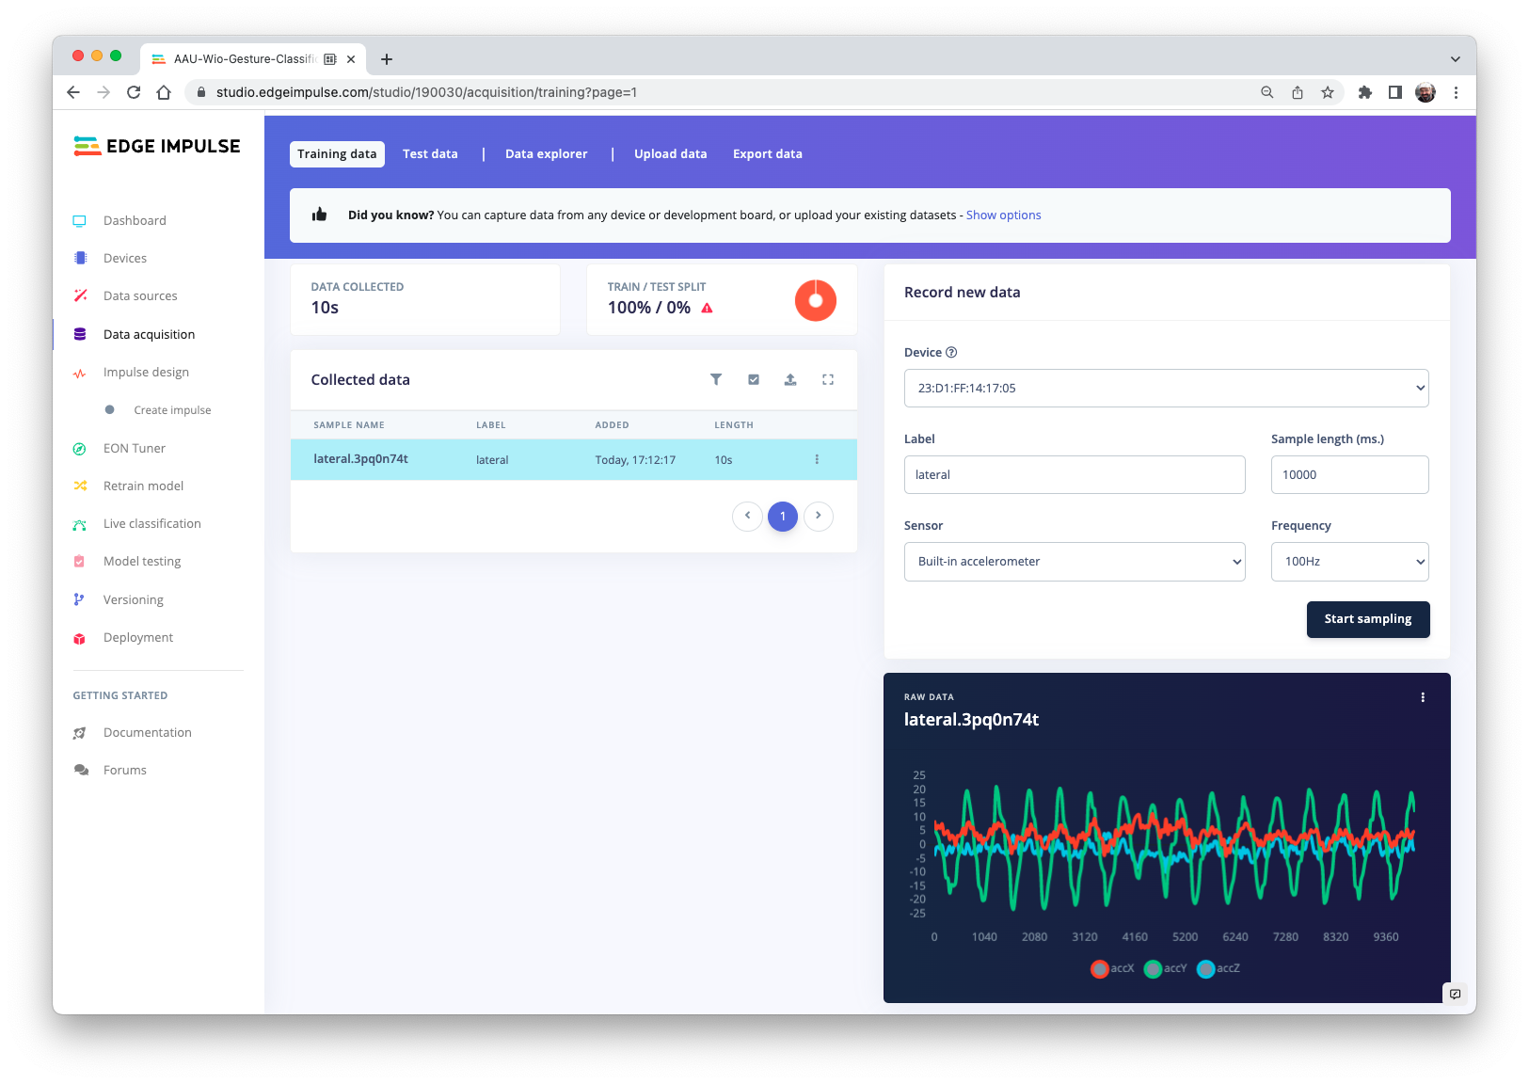
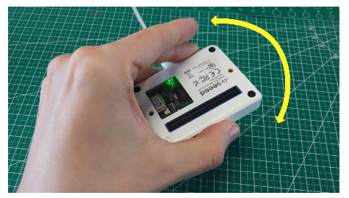

Slide 28
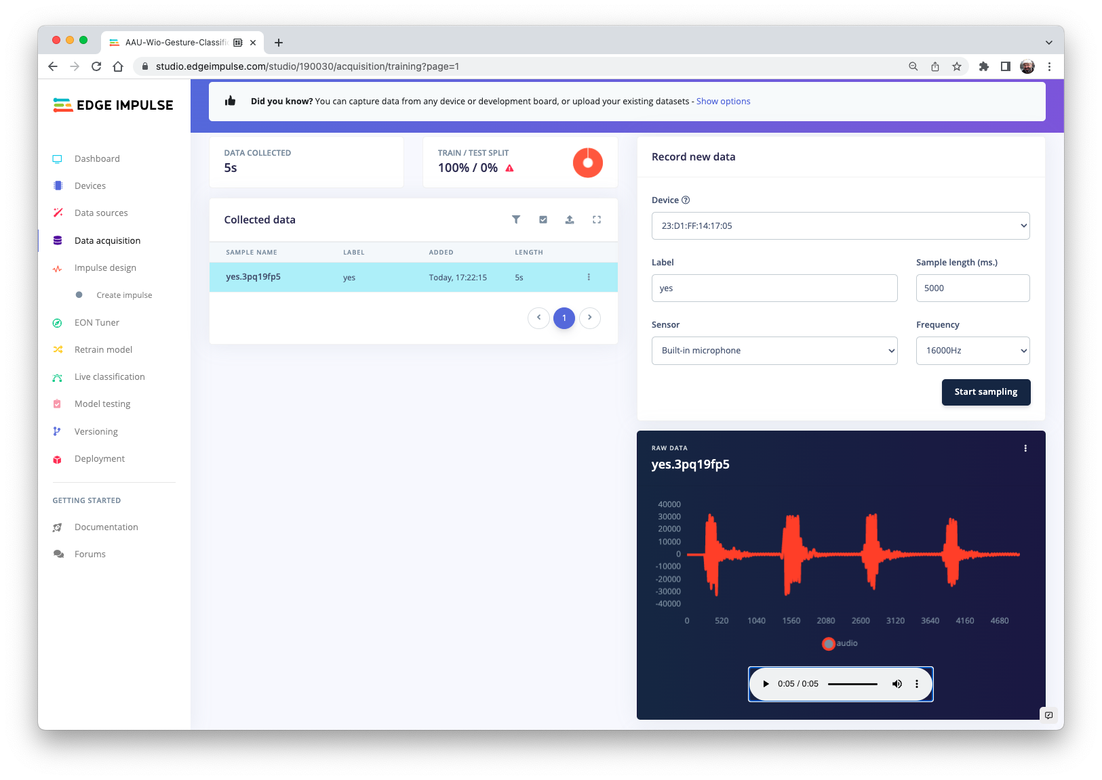
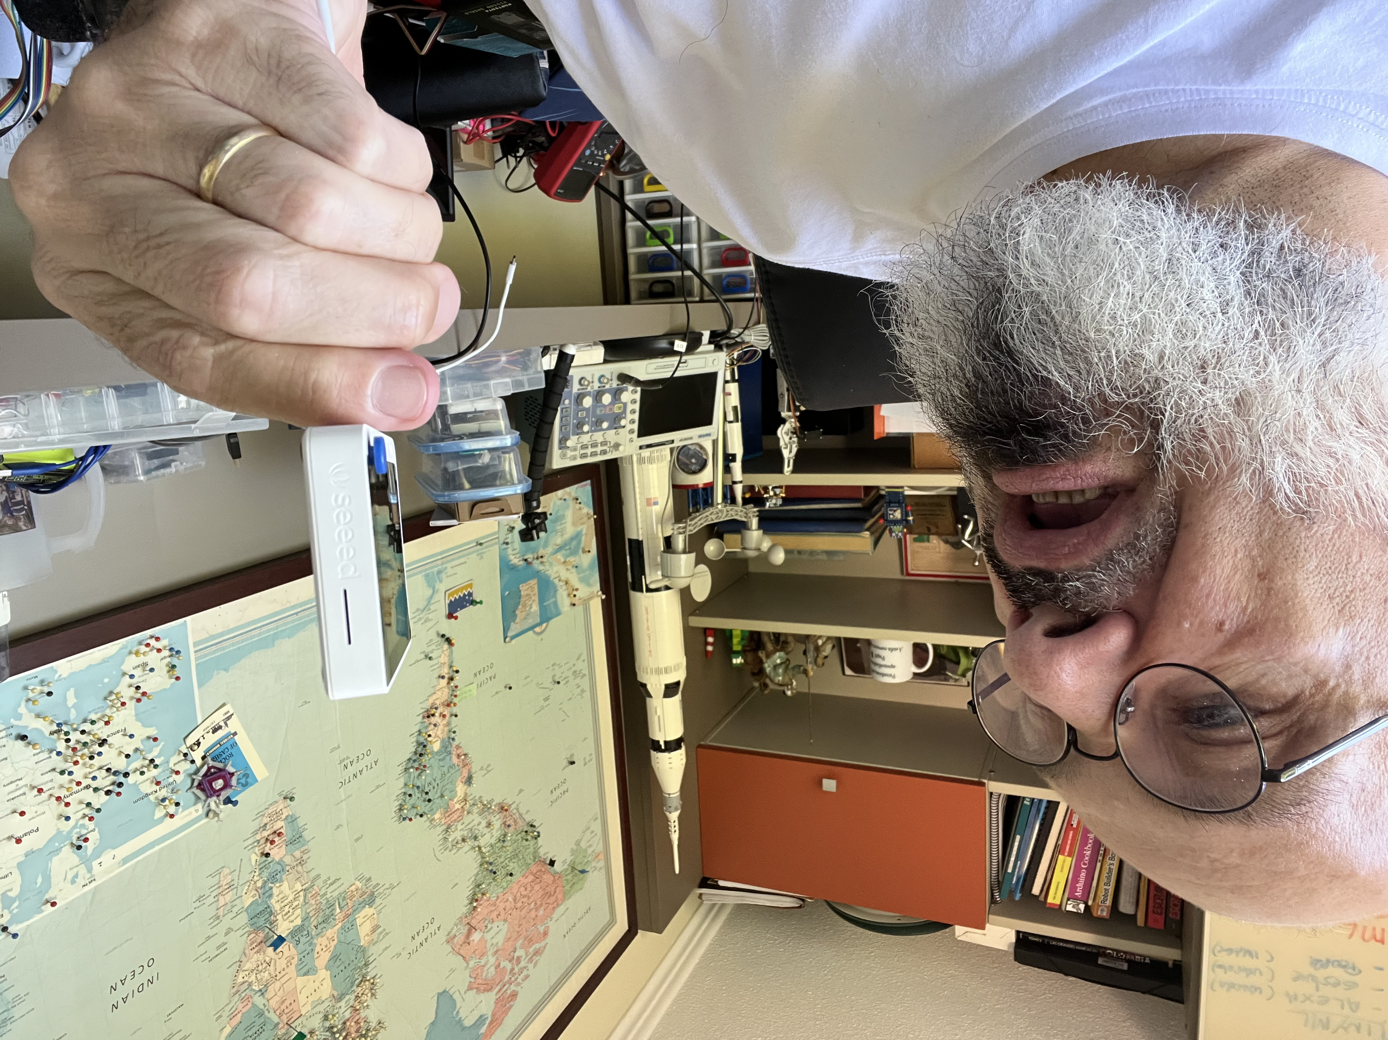


Slide 29
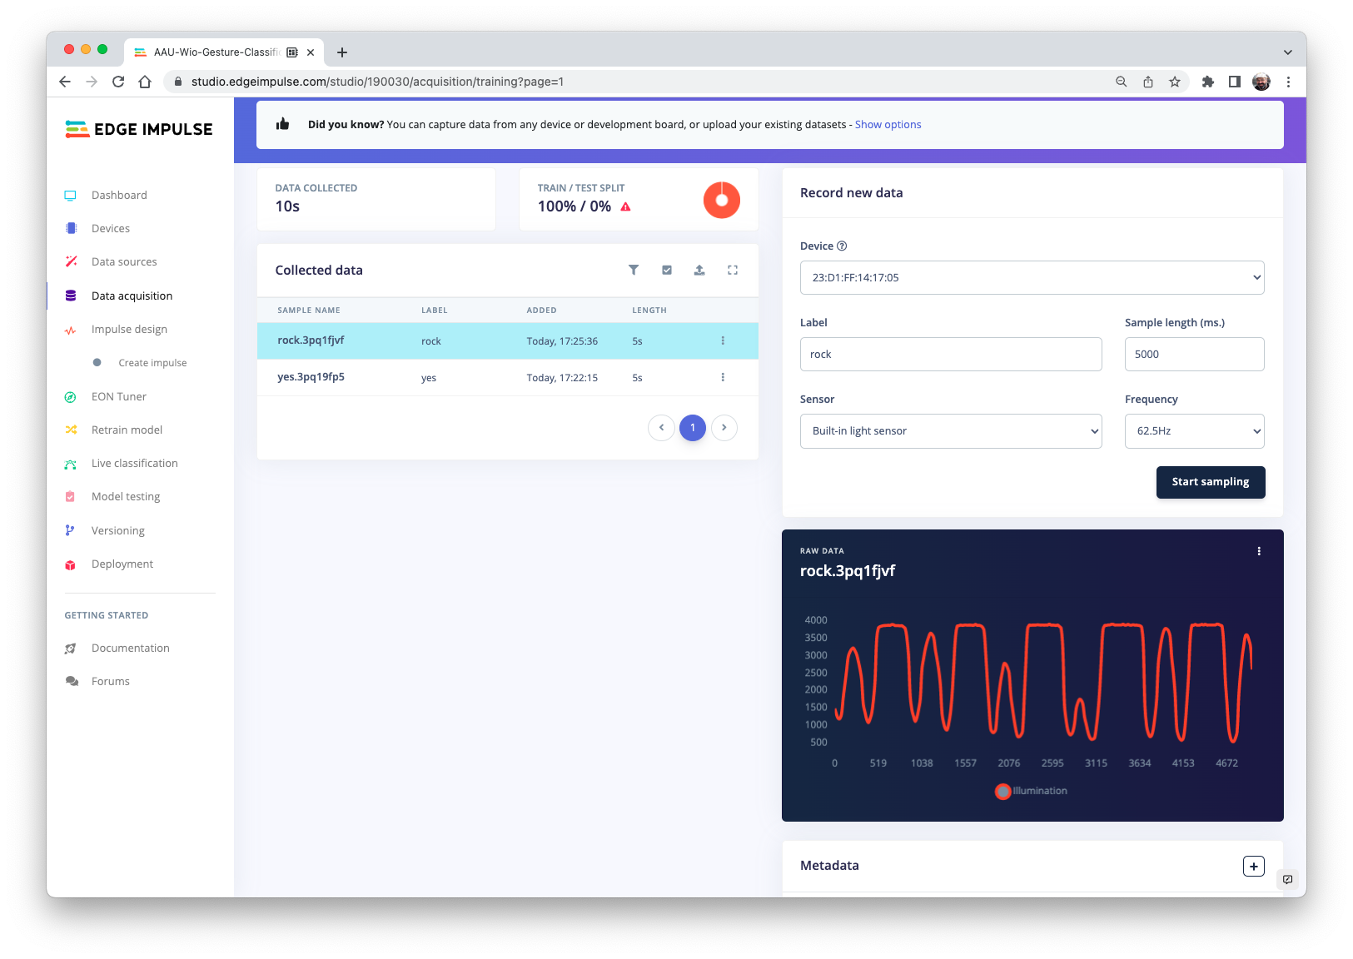
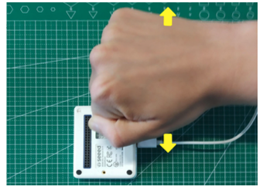

Slide 30
Thanks

